Slide 1
JNCIS-ENT
Border Gateway Protocol (BGP)

Slide 2
BGP Lab
7
Configuring, monitoring and troubleshooting iBGP and eBGP

Slide 3
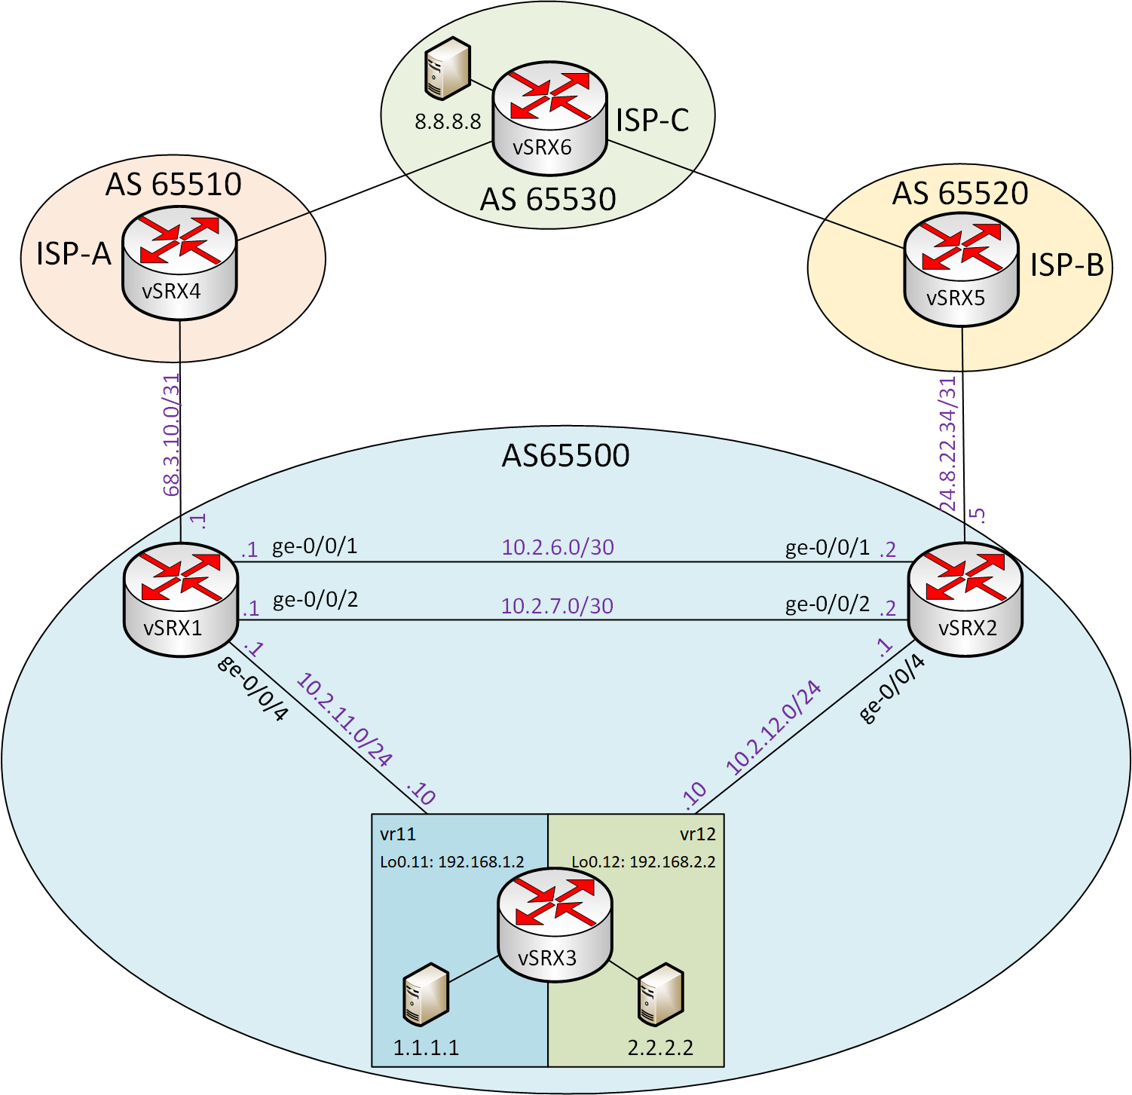
Diagram

Slide 4
Configuring and Monitoring iBGP
Review starting configurations on vSRX1, vSRX2, vSRX3
Review routing table on vSRX1 and vSRX2
On vSRX1:
3. Configure local autonomous system 65500
4. Configure iBGP group and peers and commit
5. Set iBGP group as internal and commit
6. Review BGP summary and received routes
On vSRX2:
7. Configure local autonomous system 65500
8. Configure iBGP group and peers with peer-as and commit
9. Review BGP summary and received routes

Slide 5
Configuring and Monitoring eBGP
On vSRX1:
1. Configure eBGP group and peer ISP-A
2. Reviewed advertised routes to ISP-A and received routes on vSRX1
3. Configure advertise-inactive and review advertised routes to ISP-A again
On vSRX2
4. Configure eBGP group and peer ISP-B with advertise-inactive
On vSRX6
5. Review route table entries for 1.1.1.1 and 2.2.2.2
On vSRX2
6. Configure AS-path prepending for all routes advertised to ISP-B
On vSRX6
7. Review route table entries for 1.1.1.1 and 2.2.2.2

Slide 6
Configuring next-hop-self
On vSRX3:
1. Review vr11 and vr12 route table entries for 8.8.8.8
On vSRX1 and vSRX2:
2. Configure route policy with following information
a. From external BGP routes
b. Then next-hop self
3. Set route policy as an export policy on iBGP group and commit
On vSRX3:
4. Review vr11 and vr12 route table entries for 8.8.8.8

